Slide 1
Rutgers Data Science – Tableau Visualization Assignment
Submitted By: Jacqueline McBean-Blake
Date: January 18, 2020

Slide 2
Citibike Analysis
Data to analyze NY Citibike was retrieved for July – November 2019.
The csv files were exported to Jupyter Notebook where the months July to November were added, and a sample size of 100,000 records were extracted in order to load the data more easily and faster.

Slide 3
Phenomenon I
The first unexpected phenomenon I observed was that the Citibike venture was such a great success. The numbers of start and end stations, subscribers, and customers grew exponentially in a very short time-frame from the inception in 2013 to 2019.
There are a number of possible reason for the great success of the Citibike venture in NY;
this form of transportation is cost effective compared to Uber or Lyft or regular taxis.
This produces no pollution or emissions in the environment.
Enables a faster mode to get from place to place.
Considered a great source of exercise
The visualization below depicts the number of Start and End Stations and the Users both Subscribers and Customers.

Slide 4
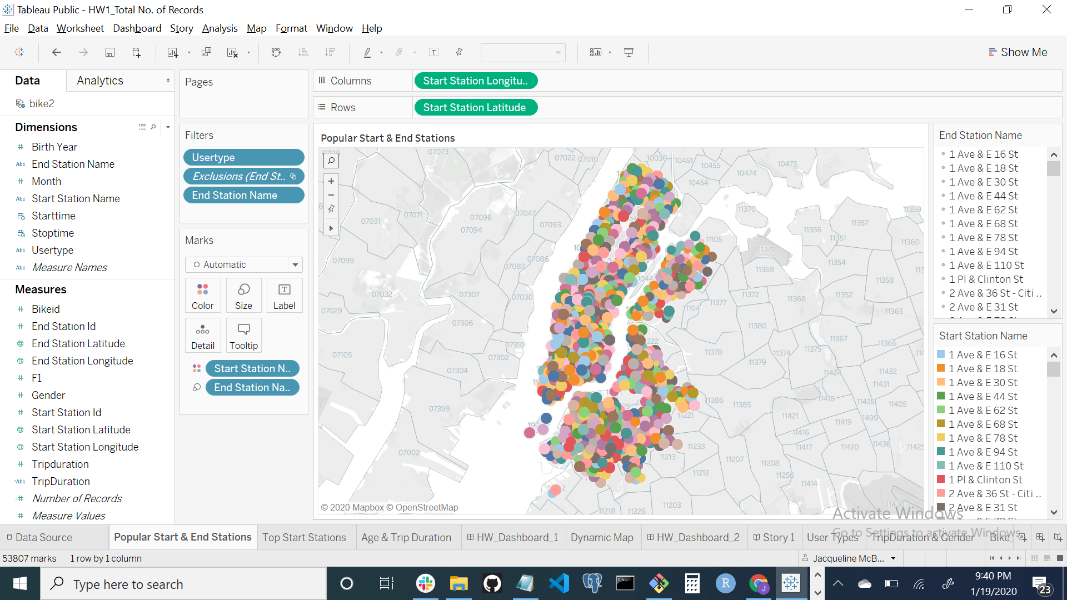
Visualization I – Total Records

Slide 5
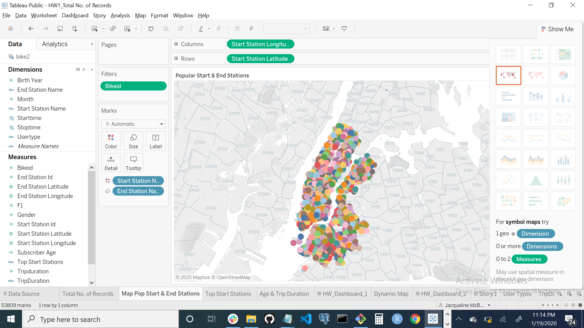
Visualization II -Map with Popular Start & End Stations

Slide 6
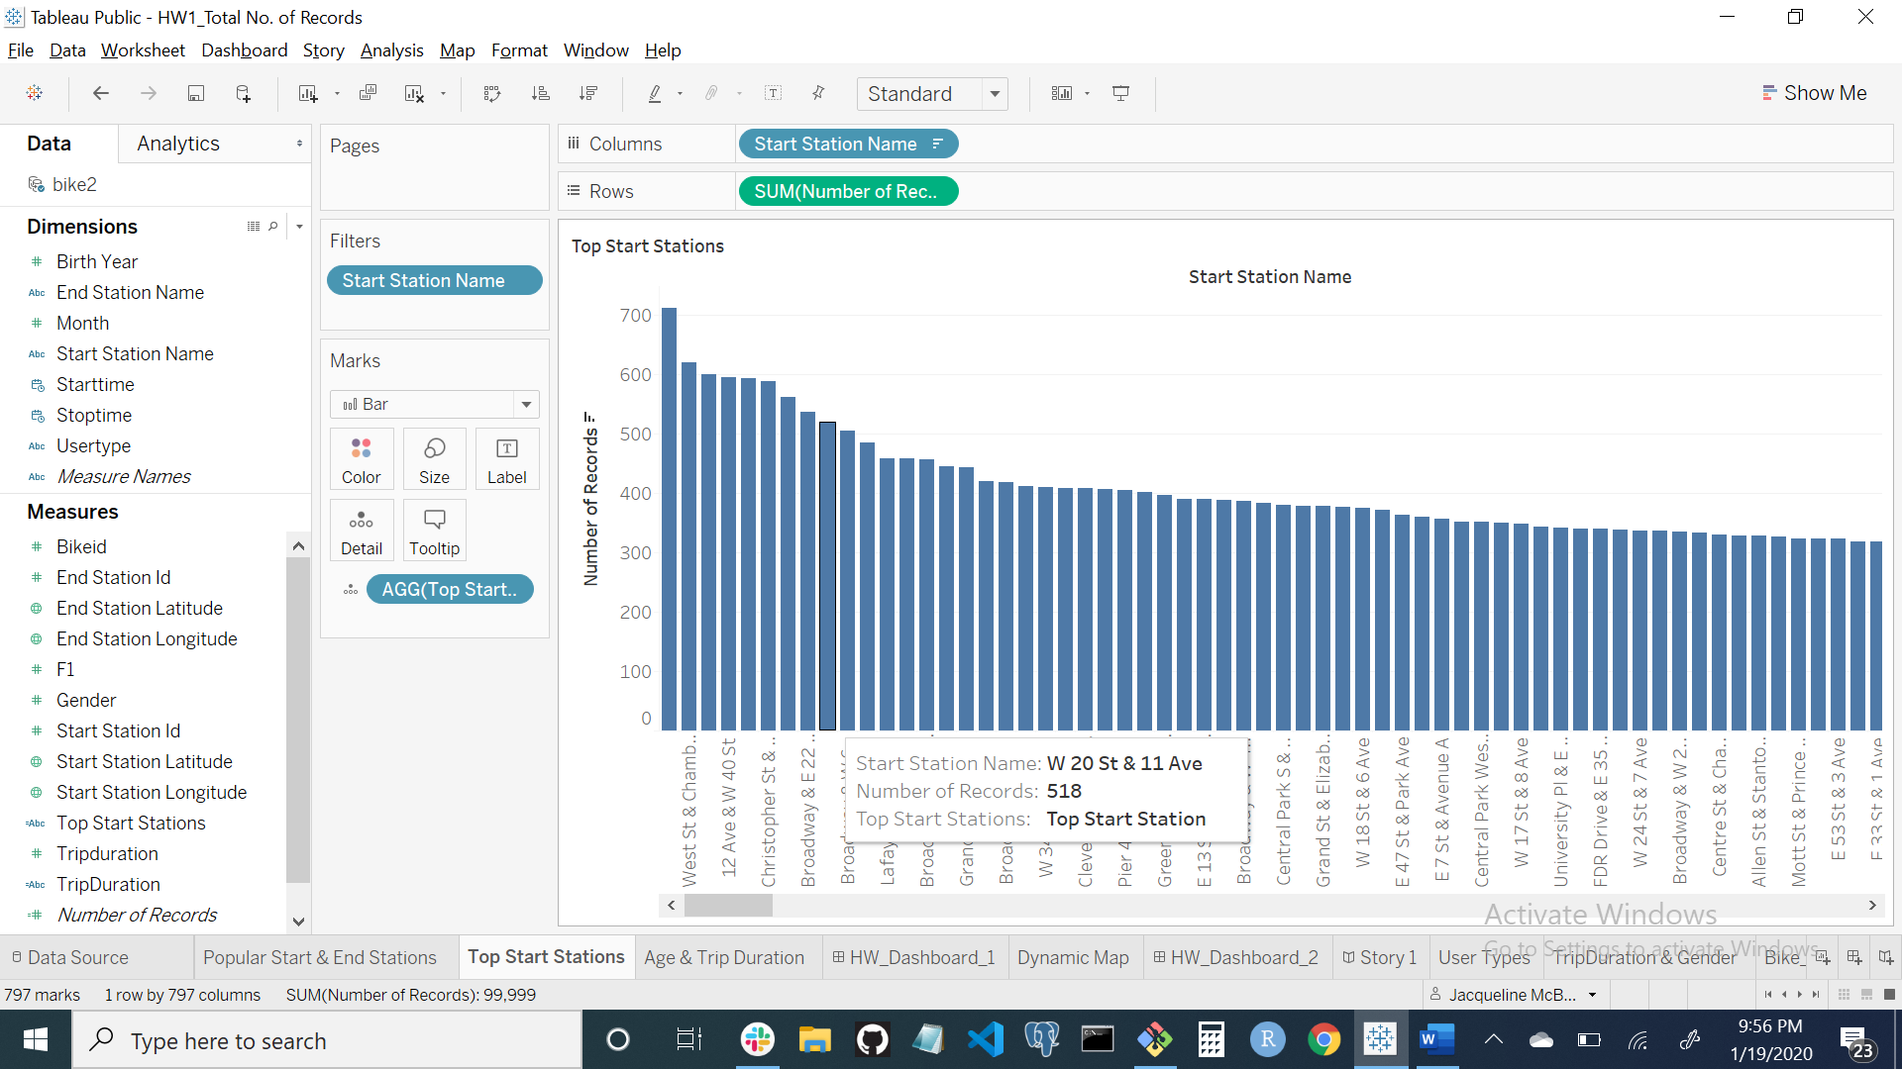
Visualization III – Top Stations

Slide 7
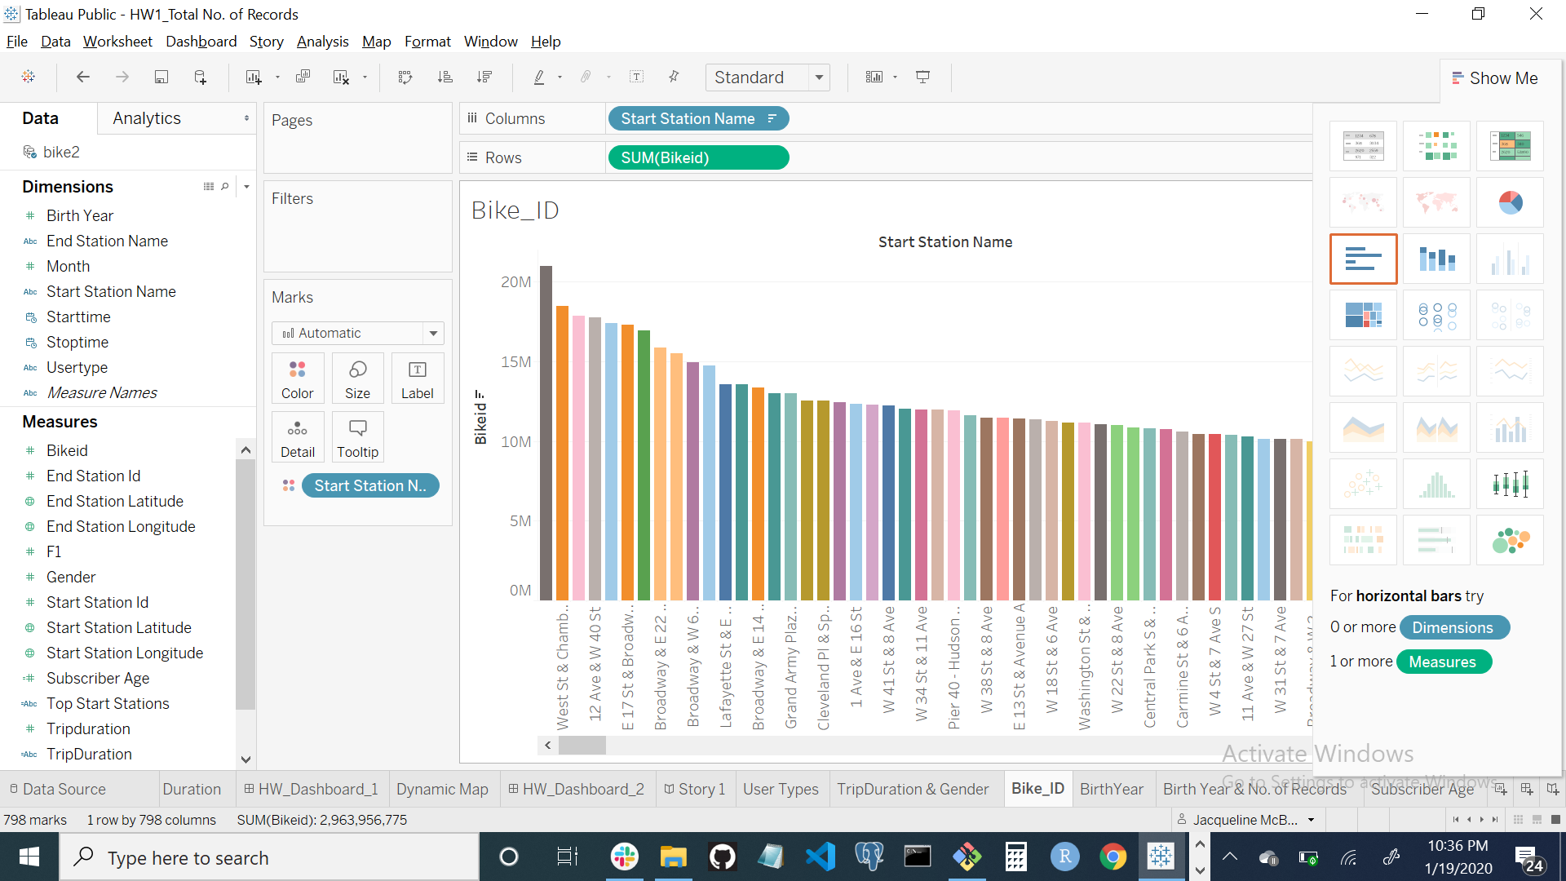
Visualization IV – Bike ID & Start Stations

Slide 8
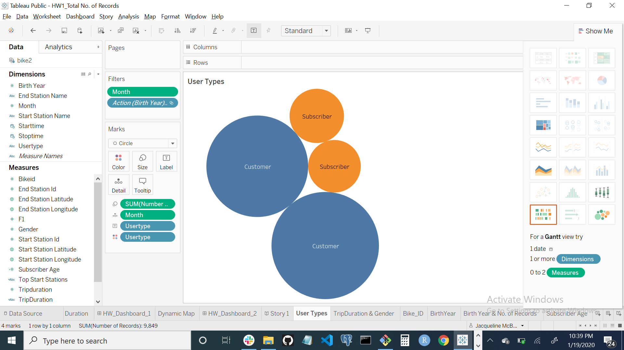
Visualization V – User Types

Slide 9
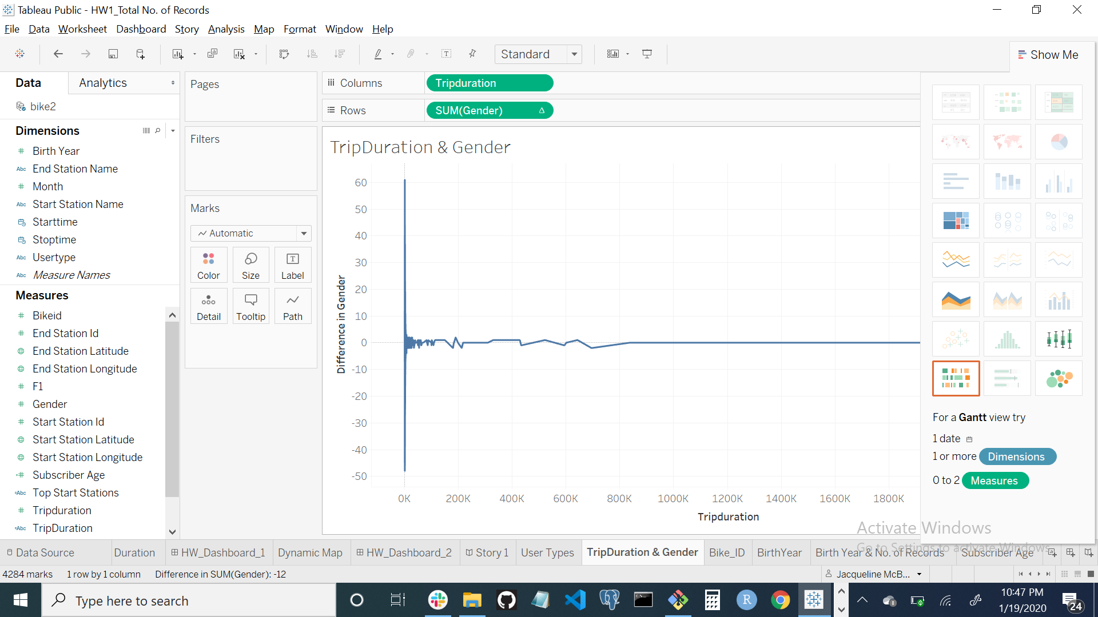
Visualization VI - Trip Duration & Gender

Slide 10
Phenomenon II
The second unexpected phenomenon I encountered was that the highest total number of users were fifty years old.
There could be several possible reasons for this;
Users who are middle age would consider this to be a great source of exercise.
Subscribers and Customers would find this a faster mode to get from place to place in the city.
There may be a greater number of middle-aged persons working in the New York Metro area.
The visualizations below depicts the age-related analysis for the Users both Subscribers and Customers.

Slide 11
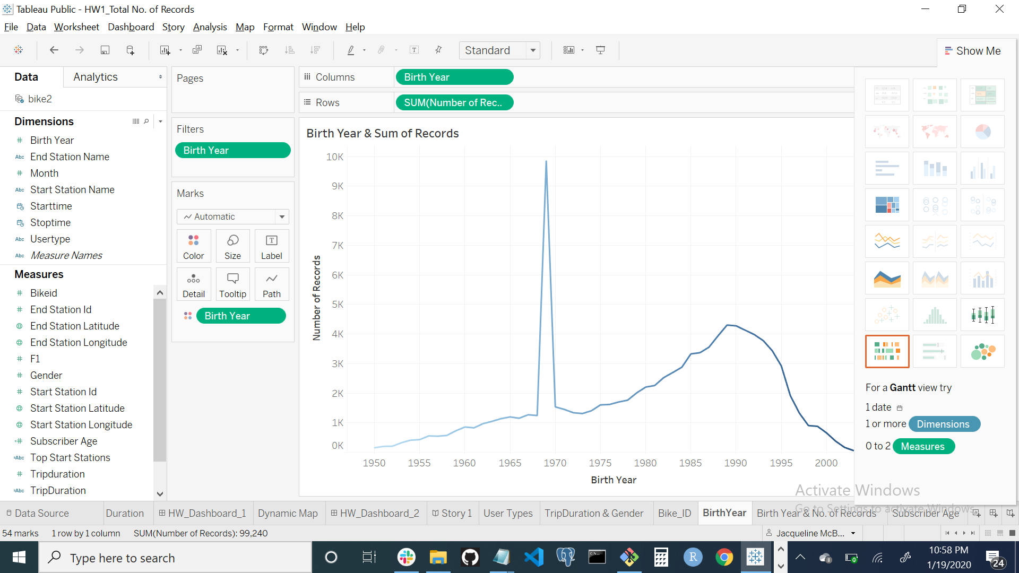
Visualization VIII - Birth Year & Sum of Records

Slide 12
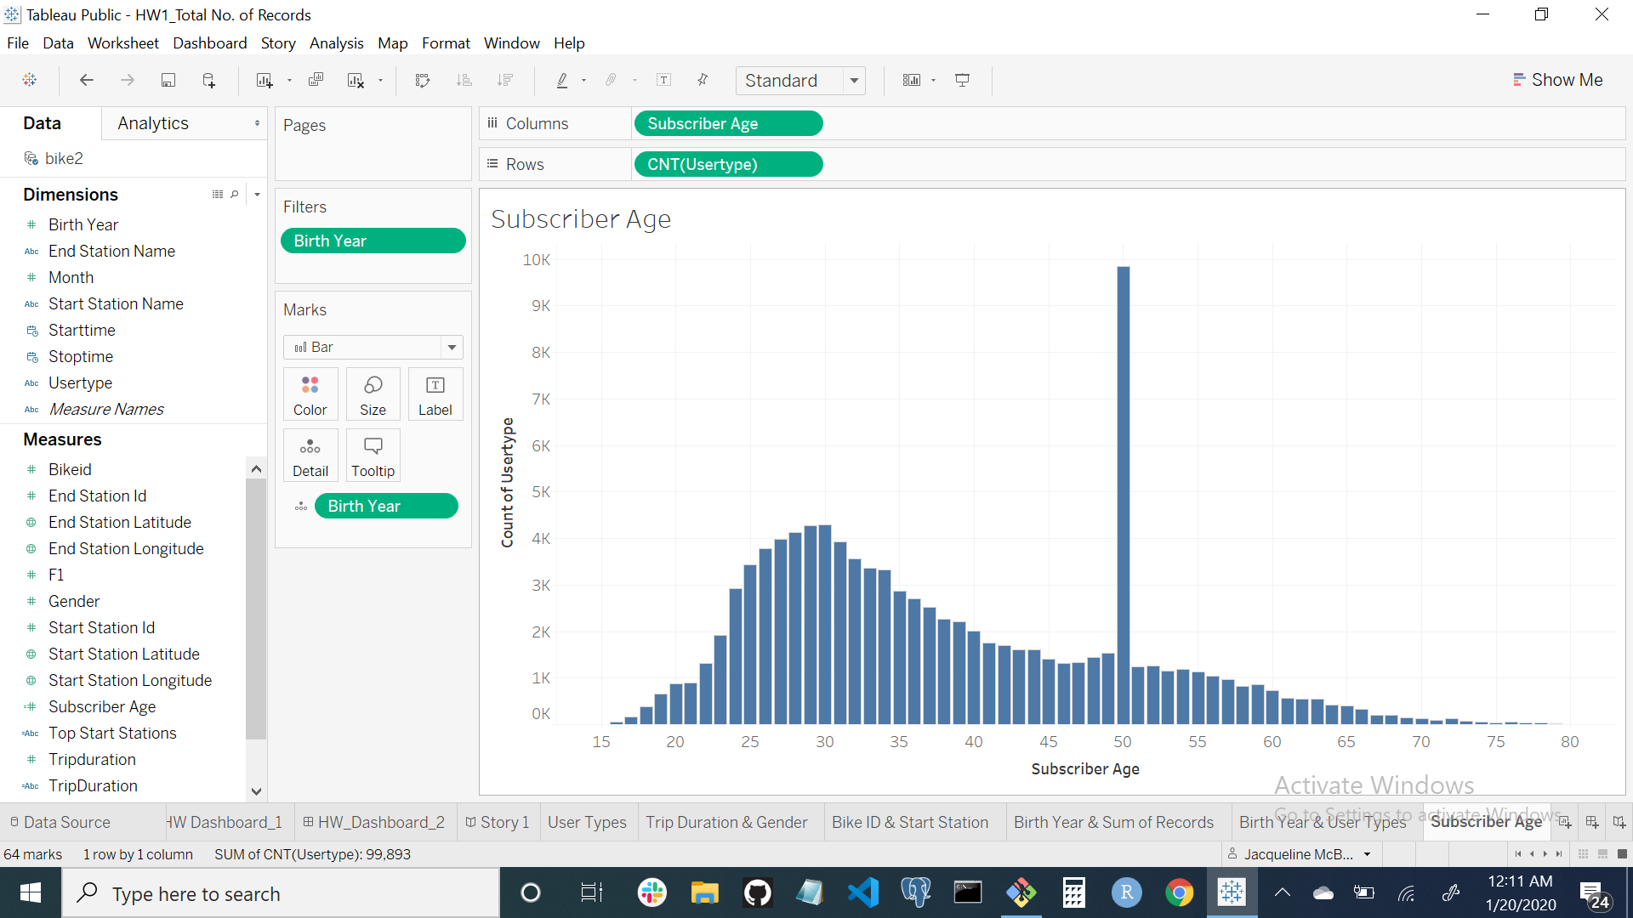
Visualization IX - Subscriber Age & User Type

Slide 13
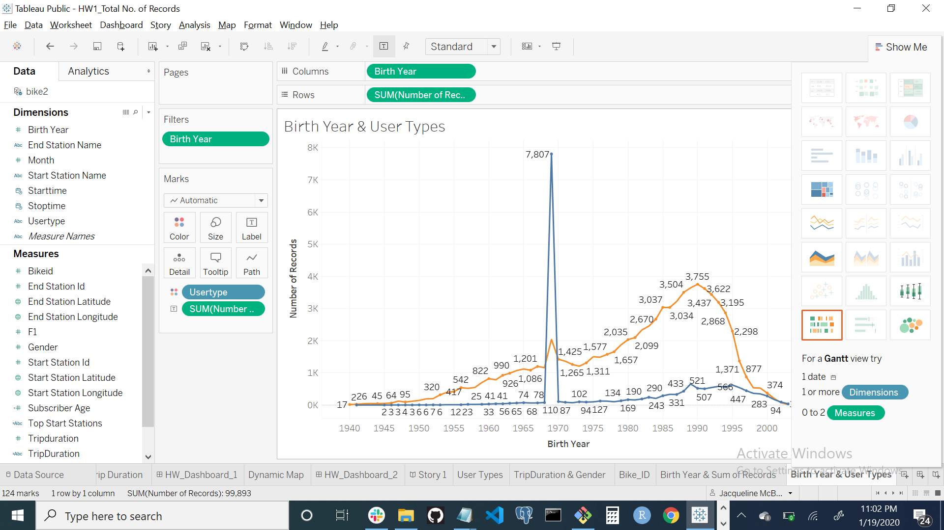
Visualization X - Birth Year & User Types

Slide 14
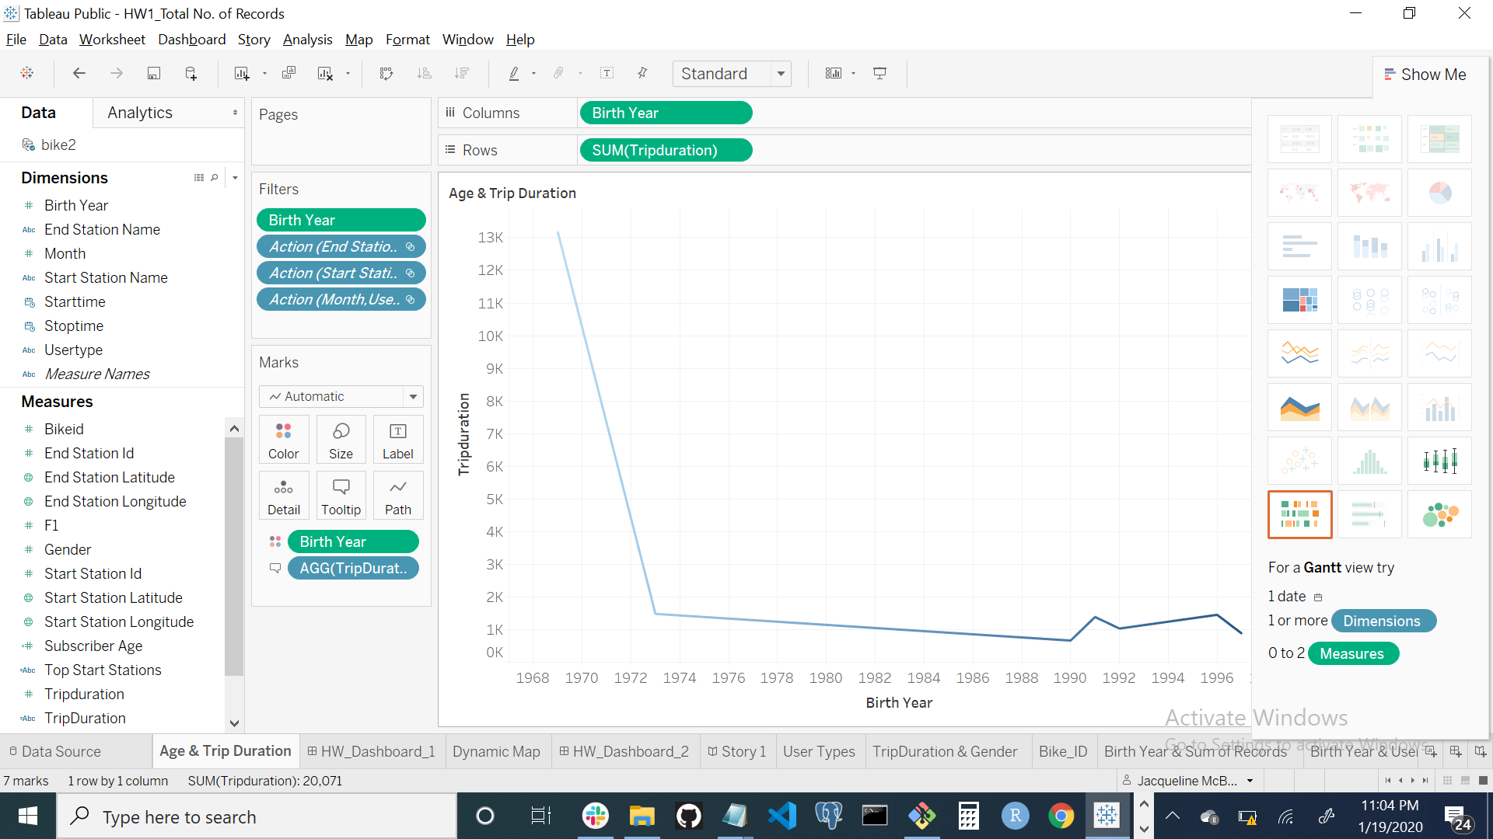
Visualization XI - Birth Year & Trip Duration

Slide 15
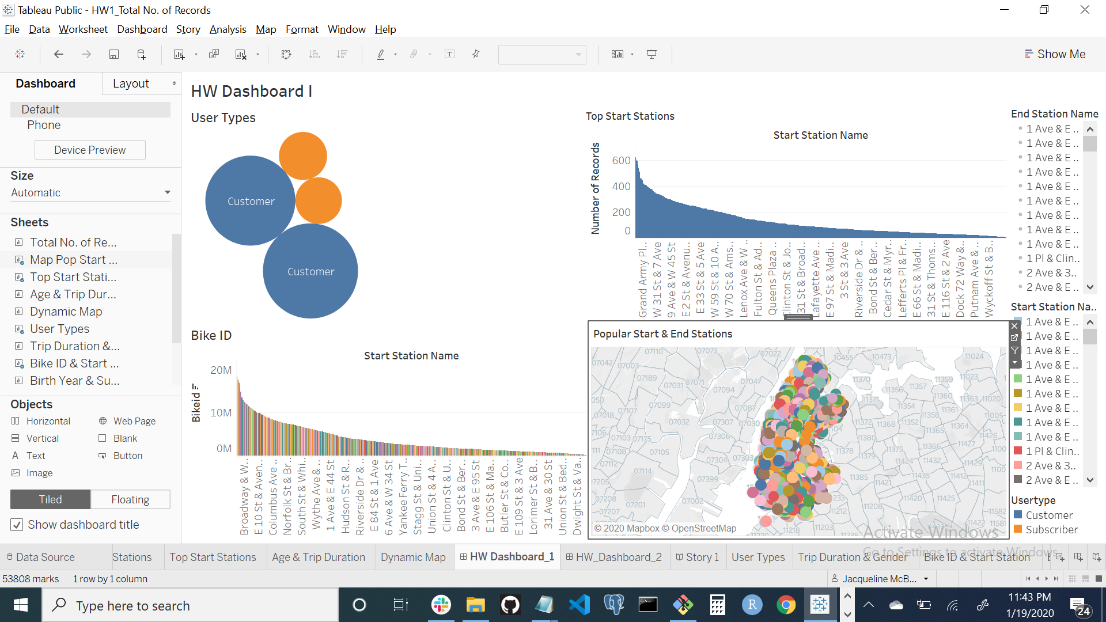
Visualization XII - Dashboard I

Slide 16
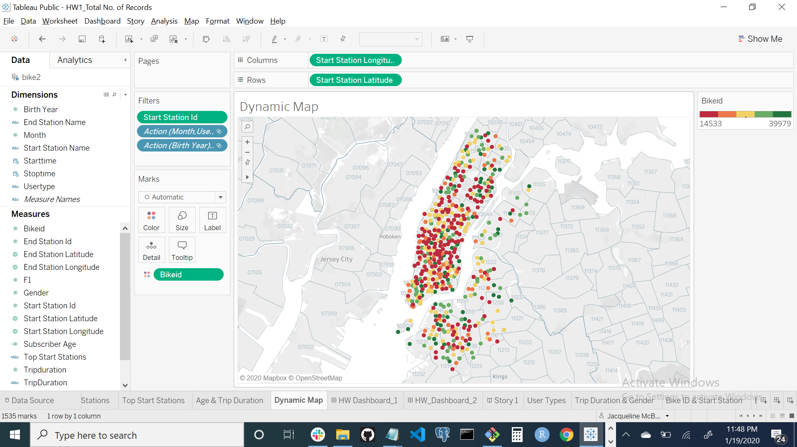
Visualization XIII - Dynamic Map

Slide 17
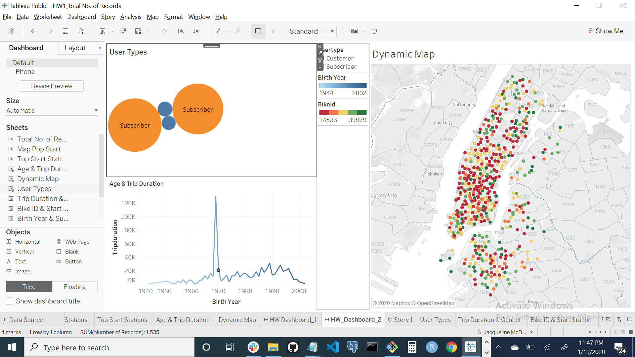
Visualization XIV - Dashboard II

Slide 18
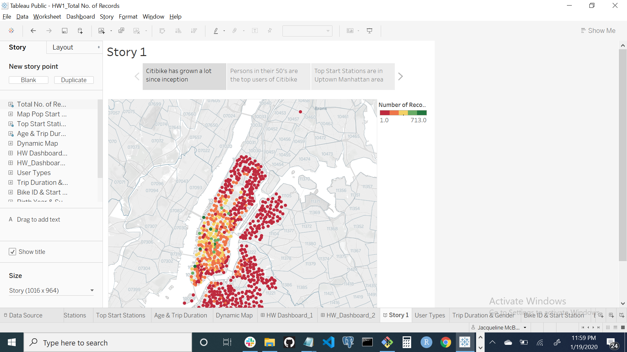
Visualization XIV - Story Citibike has grown a lot since it became operational

Slide 19
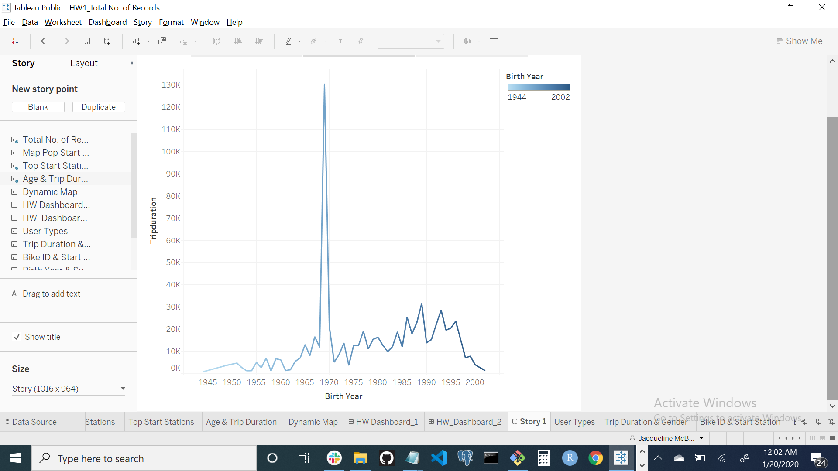
Visualization XV - Persons in their 50’s are the top users of Citibike

Slide 20
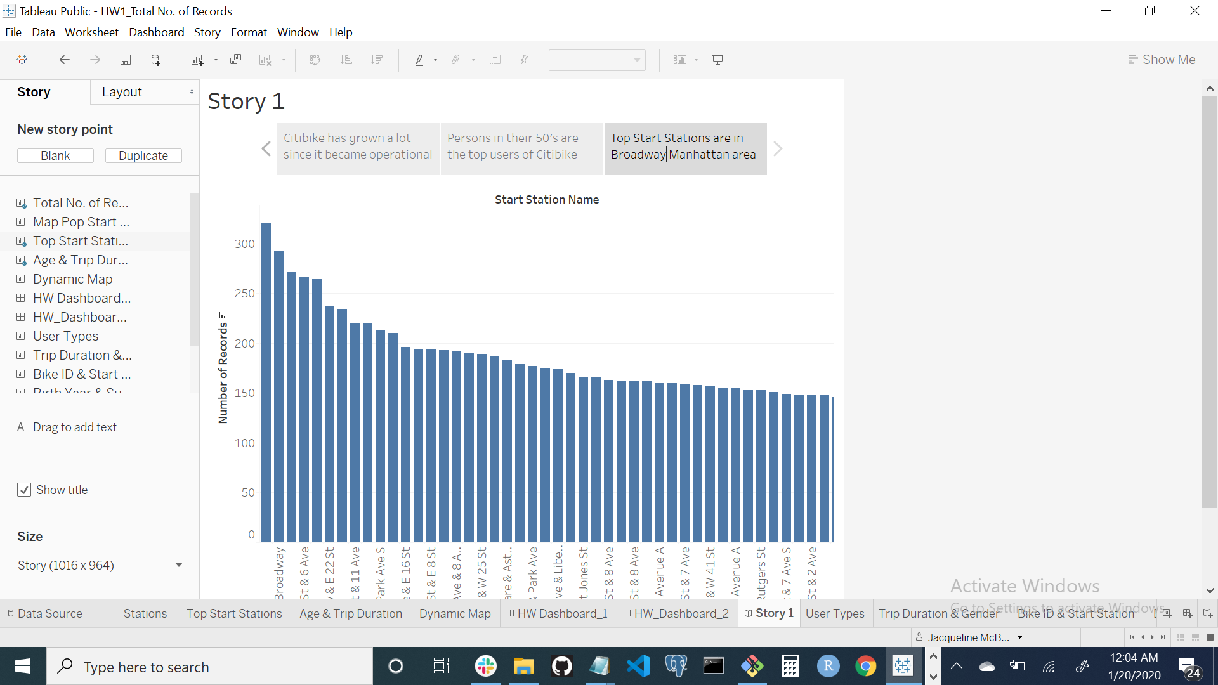
T Visualization XVI - Top Start Stations are in the Broadway Manhattan area

Slide 21
Conclusion
The concept of Citibike is a great one that is borne out by a successful reality. I think based off the data that Citibike in New York will continue to grow and expand into the Tristate area.

